Slide 2
CHALLENGES FARMERS
FACE TO ACCESS
FINANCIAL SERVICES
By : Marthe Paauwe (Regional Programme Director) & Jean de Dieu Ndacyayisenga (Project Manager)

Slide 3
Contents
SPARK Overview
Introduction
Smallholder Farmers Challenges in accessing financial services
From Challenges to Solutions
Role of cooperatives
Other Key Partners Intervention required

Slide 4
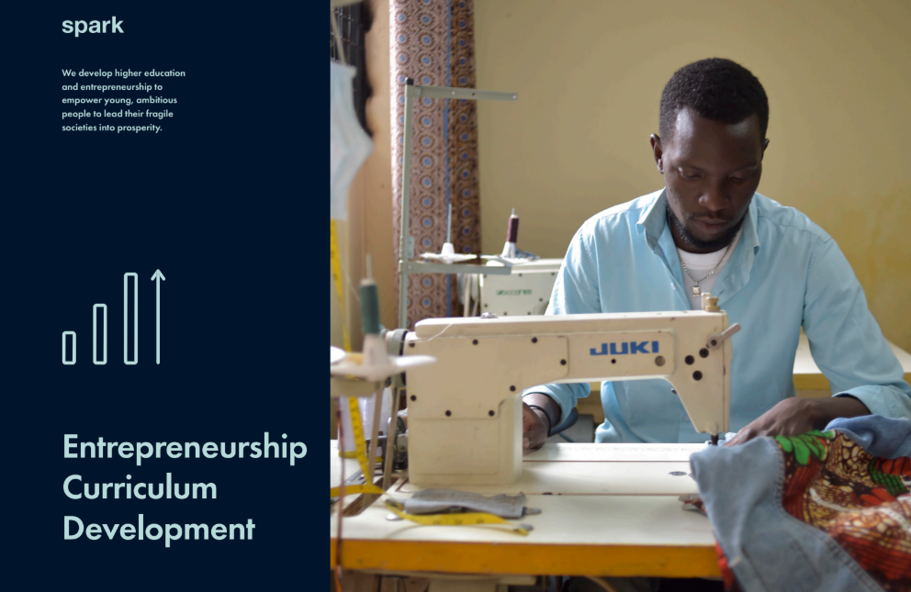
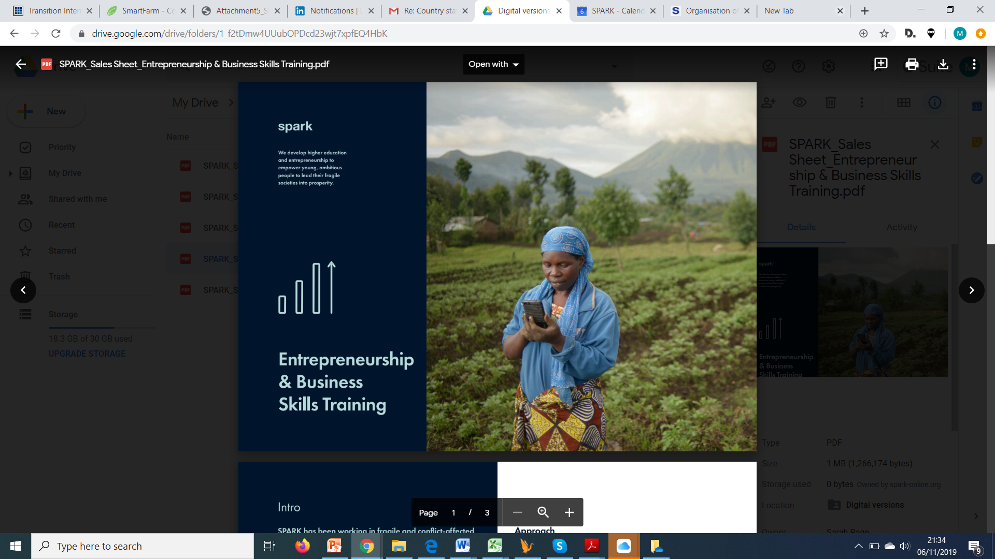
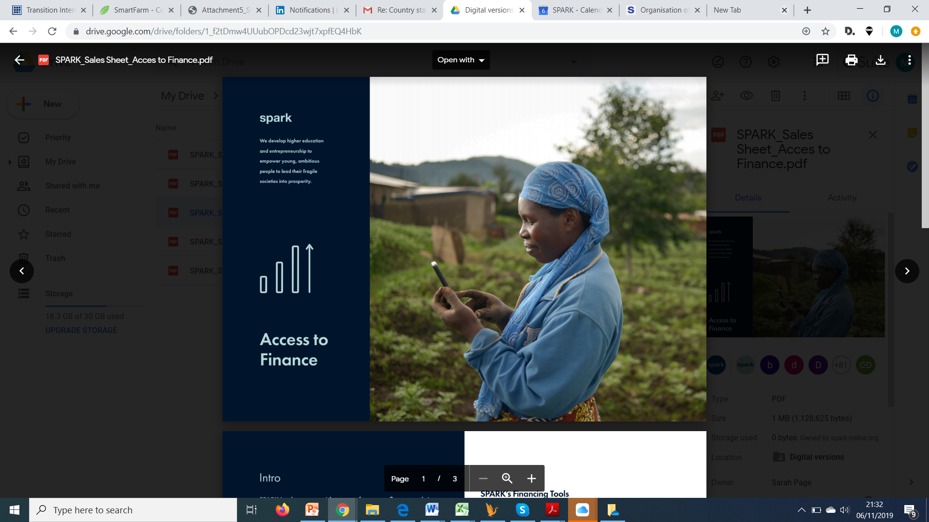
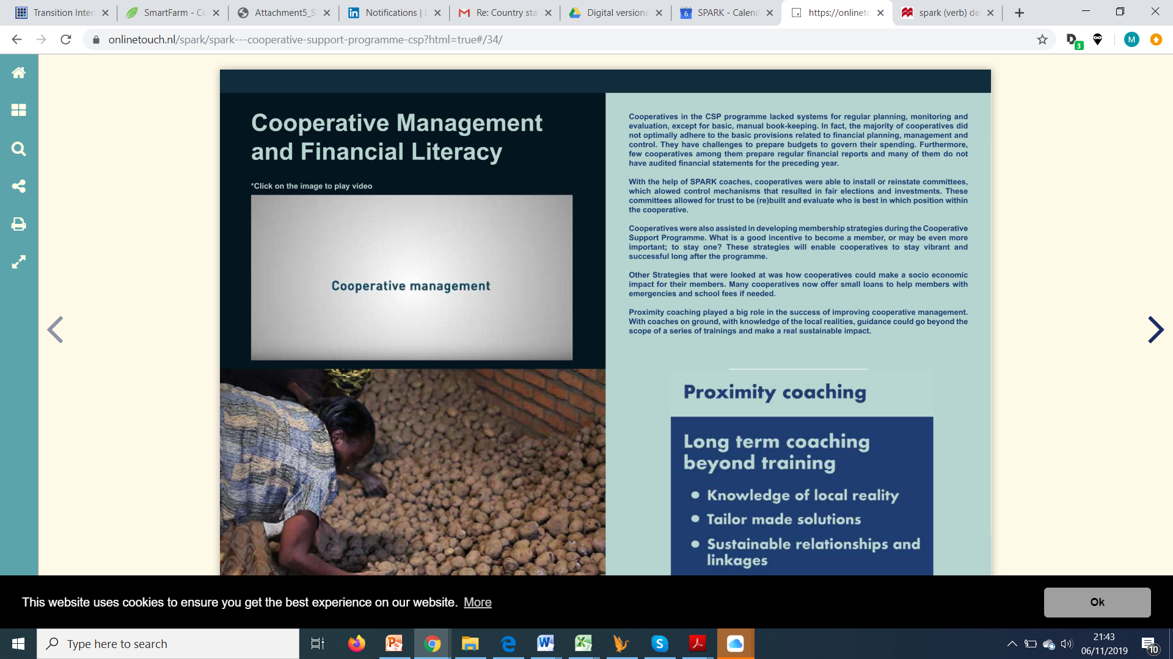
SPARK OVERVIEW
We aim to spark:
Job Creation and Economic empowerment
With a strong focus on Youth and Rural communities

Slide 5
SPARK OVERVIEW
Enterprise Development
(start-ups & growing SMEs)
Access to Market & Access to Finance strengthening
Agriculture Cooperatives & Agri-business support
SPARK Rwanda
(Digital) innovations to ignite ambitions

Slide 6

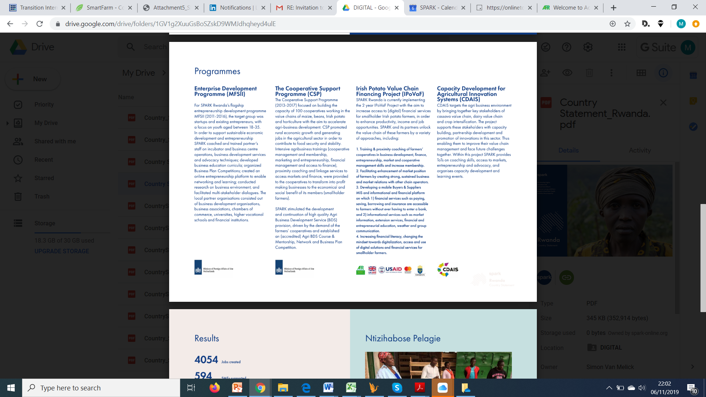

Business training & Proximity coaching
Enhancement of market position of farmers
Implementation of Digital Platform
Increasing financial literacy and building trust

Slide 7
Introduction
Smallholder farmers represent the biggest employment sector in rural areas of the developing world
Farmers are also the most important contributors to the Rwanda food production and thus food security
Smallholder Farmers need financial services to finance their agriculture activities and other household needs

Slide 8
Introduction Con’t
Supply side
High willingness of goverment and donors in:
Creating supportive ecosytems and policies;
In developing appropriate financial services and products like mobile services and innovative ways to capture farmers information (sensor’s, drones, phones, etc.)
In introducing agriculture insurance schemes for the smallholder formers.
Demand side
Farmers are still facing a lot of challlenges towards accessing financial services to increase production and income levels.

Slide 9
MAIN CHALLENGES FARMERS FACING TO FINANCIAL SERVICES
Small holder Farmers are not considered as Potential clients by most Financial Institutions
Lack of farmers data for financial institutions
High cost to serve isolated farmers
Lack of collateral
Lack of agriculture or crop insurance scheme
Limited understanding of Agriculture value chain by FIs
Farmers’ illiteracy & trust towards new technology

Slide 10

SMALL HOLDER FARMERS ARE NOT CONSIDERED AS POTENTIAL CLIENTS BY FINANCIAL INSTITUTIONS
Too risky
Too scattered
Too poor

Slide 11
LACK OF FARMERS’ DATA
Issues for FIs in farmer data information that help them to build a credit profile and deliver loans to smallholder:
Not having such data at all;
or not complete (incentives for farmers, fear)
or not reliable (built in control mechanisms)
or a mismatch between owner and user in case of collection through phone

Slide 12
HIGH COST TO SERVE ISOLATED FARMERS
The fact that many farmers are not collectively organized result in high costs. Isolation results in:
  Lack of information vis a vis finance
  Lack of power of advocacy
  Lack of access to trainings/coaching on financial education, business plan, financial literacy, entrepreneurship, etc. which led to the poor mindset towards finance access and being a reliable client for banks.

Slide 13
LACK OF COLLATERAL
Smallholder farmers do not own the land
Others do not own fixed assets
Others are renting land
Lack of farmers’ guarantee fund
Financial institution accept FIXED ASSETS to access financial services (Agriculture loan)

Slide 14
LACK OF AGRICULTURE OR CROP INSURANCE SCHEME
Lack of insurance scheme on agriculture value chain
Lack of guarantee fund for crop insurance
Lack of farmers awareness on agriculture insurance
Limited skills on agriculture insurance

Slide 15
LIMITED UNDERSTANDING OF AGRICULTURE VALUE CHAIN BY FIS
No research conducted to decide whether to invest in Agri-loan and related to suitable Financial Products
High interest rate for available products
Lack of financial product in agriculture to address farmers’ challenges
FIs fear the agriculture risks (High Risk)
FIs always look at Formal Business Contract and other collaterals.

Slide 16
FARMERS’ ILLITERACY TO NEW TECHNOLOGY
Many Farmers are illiterate which is affect their usage and accessible ICT services
Lack of skills and knowledge on ICT tools
Lack of appropriate product for both literate and illiterate farmers
Farmers’ don’t trust technology lead to lack of accurate information (Mindset)
Farmers’ providing wrong information in using technology

Slide 17
ROLE OF FARMERS ORGANIZATIONS (COOPERATIVE) IN ADDRESSING CHALLENGES
The Agriculture cooperatives has the great role in solving financing problems of smallholder farmers due to different factors such as:
  Planning & Strategy
  Easy Provision of data for farmers
  Easy awareness campaign raising

Slide 18
PLANNING & STRATEGY
Agriculture cooperative has a deep understanding of their member allows cooperative
  To define their roadmap
  It also allows them to make financial forecasts
  Evaluate with high precision potential markets for various services

Slide 19
EASY PROVISION OF DATA FOR FARMERS
Profiling farmers to credit requires a lot of data needed notably:
Information about Personal identification,
Production information,
Supply or Bankable data, etc….
The cooperative can play a great role in provision of those information towards access to finance services

Slide 20
EASY AWARENESS CAMPAIGN RAISING
Innovation paths require the intensive and regular awareness campaign to get farmers aware those services that are not going to weaken their position in Value chain, their rights and obligations in the process

Slide 21
From challenges to Solutions
Small holder Farmers are not considered as Potential clients by most Financial Institutions
Lack of farmers data for financial institutions
High cost to serve isolated farmers
Lack of collateral
Lack of agriculture or crop insurance scheme
Limited understanding of Agriculture value chain by FIs
Farmers’ illiteracy & trust towards new technology
Build the business case of farmers
Create bankable data through historical supplier and buyers records
Cooperatives as entry point
Train FI staff on VC financing
Awareness campaign raising & mind-set change
Financial literacy trainings

Slide 22
Other Key Partners Interventions required
GoR to improve strategy and policy level
Financial Institutions to remove barriers to farmers in accessing financial services
Digital Services Providers in developing digital solutions with appropriate business models and user friendly interfaces
Civil society Organizations for empowering farmers.

